Slide 1


Balanced scorecard slide 1
Sentiment Analysis
Using RNN, LSTM, GRU
2020-2021

Slide 2
Author: -
Saurabh Roy (17100050)
Mail: saurabhr17100@iiitnr.edu.in
Under Supervision of: -
Dr. Muneendra Ojha
Mail: muneendra@iiitnr.edu.in

Slide 3
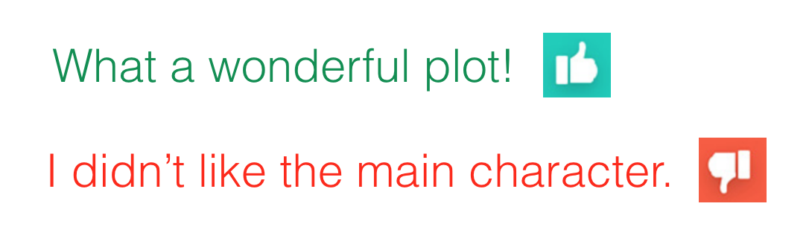
Introduction
Sentiment Analysis: The process of computationally identifying and categorizing opinions expressed in a piece of text, especially in order to determine whether the writer's attitude towards a particular topic, product, etc. is positive, negative, or neutral.

Slide 4
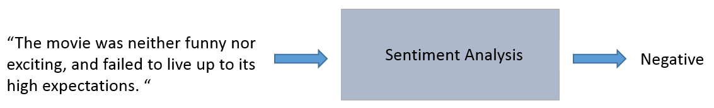
Objective of the Project
Creating three models and training them in order to perform sentiment analysis: -
Model 1 that employs Embedding layer followed by a simple RNN layer followed by a fully connected layer.
Model 2 that employs Embedding layer followed by an LSTM layer followed by a fully connected layer.
Model 3 that employs Embedding layer followed by a GRU layer followed by a fully connected layer.

Slide 5





Current Vendors
IBM tone analyzer
Amazon Comprehend
Facebook

Slide 6
Getting Data
Here, I have used the IMDB movie review dataset, loaded via keras.
This dataset includes 25,000 movies reviews from IMDB, labelled by sentiment (positive/negative).
from keras.datasets import imdb
(x_train, y_train), (x_test, y_test) = imdb.load_data(num_words=num_classification_words)

Slide 7
Data Pre-processing
The RNN will take sequences of constant length. This length is the words_limit which is defined to be 100 in my code. Since the reviews differ heavily in terms of lengths, I will trim each review to its first 100 words. If reviews are shorter than 100 words, I will pad them with zeros.
That is, if the review is ['best', 'movie', 'ever'], [117, 18, 128] as integers, the row will look like [0, 0, 0, ..., 0, 117, 18, 128]. These word encodings will be passed on to the RNN model as inputs.

Slide 8
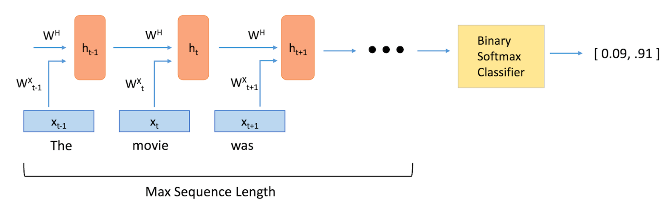
Model 1 - RNN
Where h_{t}: RNN layer at time t.
X_{t}: Word embeddings which acts as input for RNN layer at time t.
W: Represent weights.

Slide 9
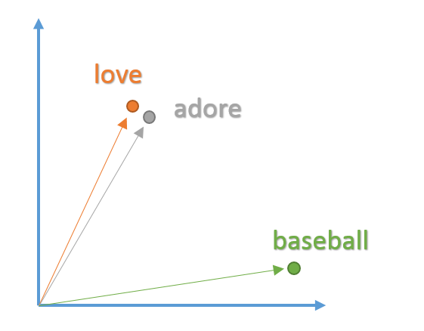
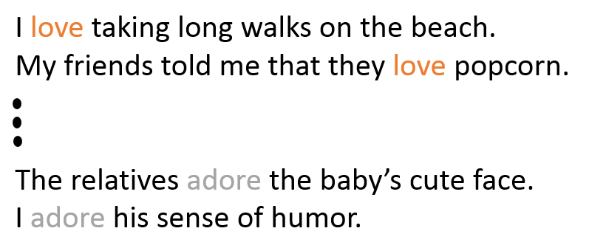
Model Layers
Embedding Layer
Word embeddings give us a way to use an efficient, dense representation in which similar words have a similar encoding.
The input dimension in our case is 100 words. The output dimension aka the vector space in which words will be embedded. In our case we have chosen 128 dimensions so a vector of the length of 128 to hold our word coordinates.

Slide 10
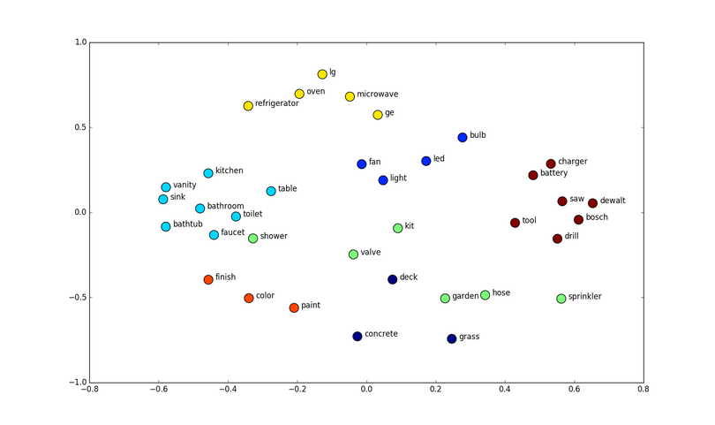
Model Layers

Slide 11

Model Layers
2) RNN layer
Each word in a sentence depends greatly on what came before and comes after it. In order to account for this dependency, we use a many-to-one recurrent neural network.
A recurrent neural network can be thought of as multiple copies of the same network, each passing a message to a successor.
In the above diagram, a chunk of neural network, A, looks at some input x_{t} and outputs a value h_{t}. A loop allows information to be passed from one step of the network to the next.

Slide 12
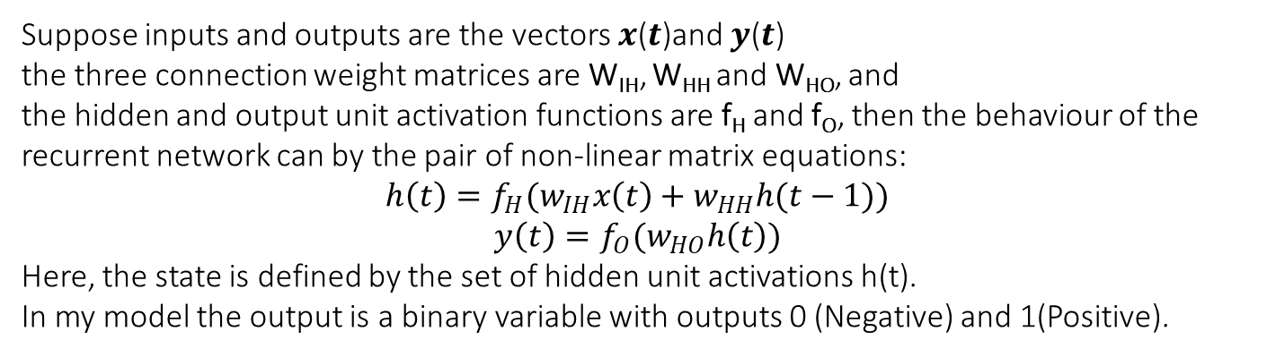
Model Layers
Suppose inputs and outputs are the vectors 𝒙(𝒕)and 𝒚(𝒕)
the three connection weight matrices are W_{IH}, W_{HH} and W_{HO}, and
the hidden and output unit activation functions are f_{H} and f_{O}, then the behaviour of the recurrent network can by the pair of non-linear matrix equations:
$$h{\left(t\right)=f}_{H}(w_{IH}x\left(t\right)+w_{HH}h(t−1))$$
$$y\left(t\right)=f_{O}(w_{HO}h\left(t\right))$$
Here, the state is defined by the set of hidden unit activations h(t).
In my model the output is a binary variable with outputs 0 (Negative) and 1(Positive).

Slide 13
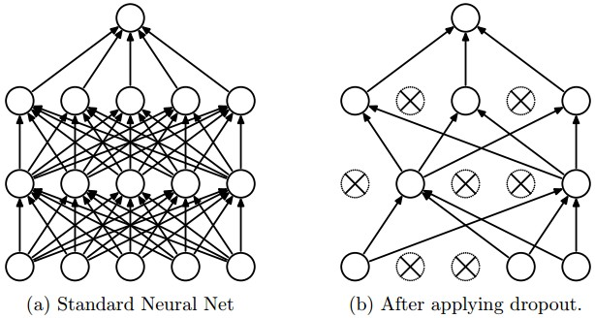
Model Layers
3) Fully Connected Layer with Dropouts
Fully Connected layers are also known as dense layer. Here each hidden layer neuron is connected to every output neurons.
Dropout is a form of regularization. It aims to help prevent overfitting by increasing testing accuracy, for each mini-batch in the training set, dropout layers, with probability p, randomly disconnect inputs from the preceding layer to the next layer in the network architecture.

Slide 14
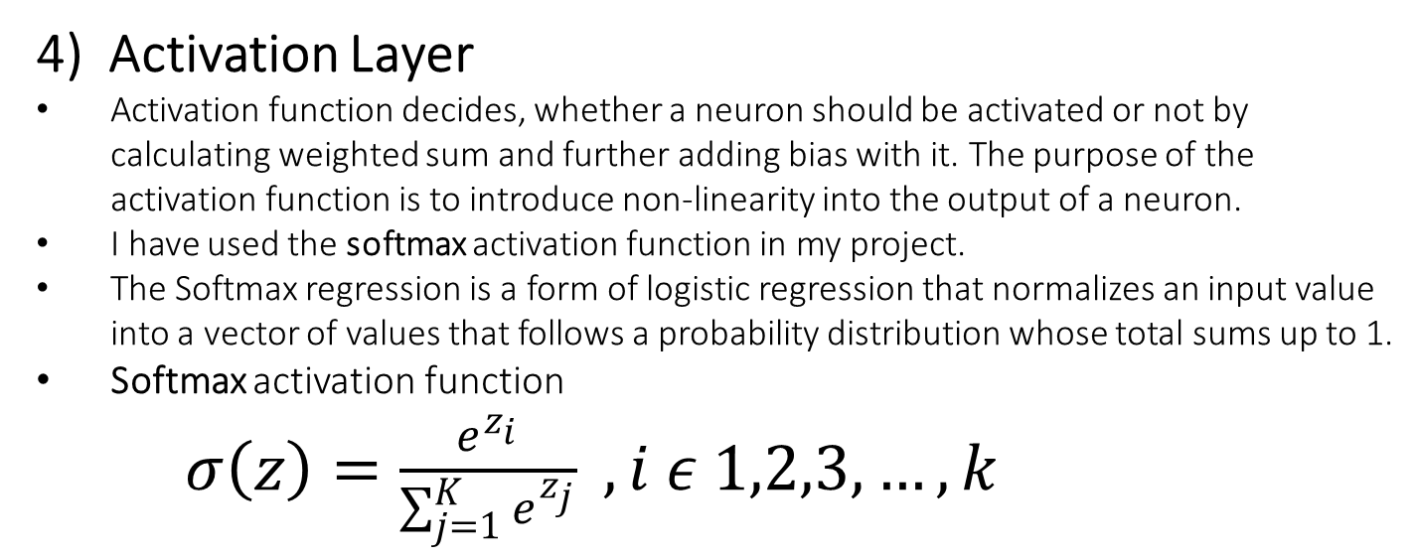
Model Layers
4) Activation Layer
Activation function decides, whether a neuron should be activated or not by calculating weighted sum and further adding bias with it. The purpose of the activation function is to introduce non-linearity into the output of a neuron.
I have used the softmax activation function in my project.
The Softmax regression is a form of logistic regression that normalizes an input value into a vector of values that follows a probability distribution whose total sums up to 1.
Softmax activation function
$σ\left(z\right)=\frac{e^{z_{i}}}{\sum_{j=1}^{K}{e^{z_{j}}}} , i ε 1,2,3,…, k$

Slide 15
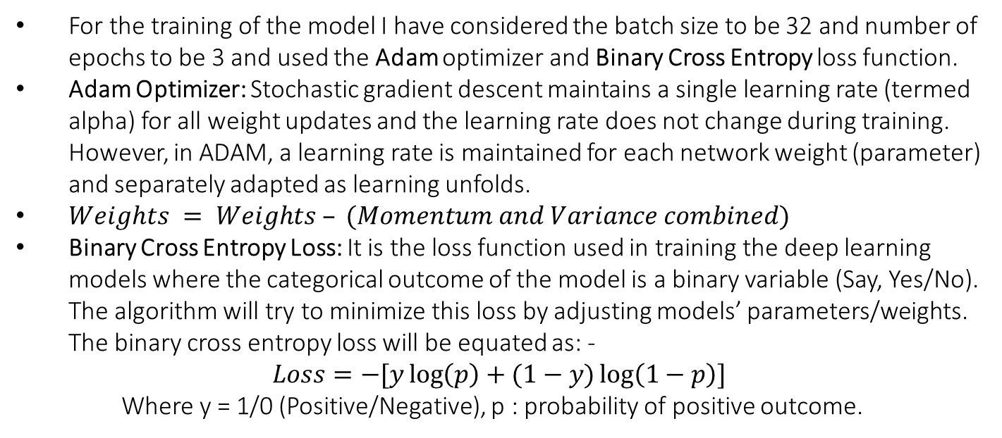
Training the model
For the training of the model I have considered the batch size to be 32 and number of epochs to be 3 and used the Adam optimizer and Binary Cross Entropy loss function.
Adam Optimizer: Stochastic gradient descent maintains a single learning rate (termed alpha) for all weight updates and the learning rate does not change during training. However, in ADAM, a learning rate is maintained for each network weight (parameter) and separately adapted as learning unfolds.
$Weights = Weights – (Momentum and Variance combined)$
Binary Cross Entropy Loss: It is the loss function used in training the deep learning models where the categorical outcome of the model is a binary variable (Say, Yes/No). The algorithm will try to minimize this loss by adjusting models’ parameters/weights. The binary cross entropy loss will be equated as: -
$$Loss=−[y\log\left(p\right)+(1−y)\log\left(1−p\right)]$$
Where y = 1/0 (Positive/Negative), p : probability of positive outcome.

Slide 16
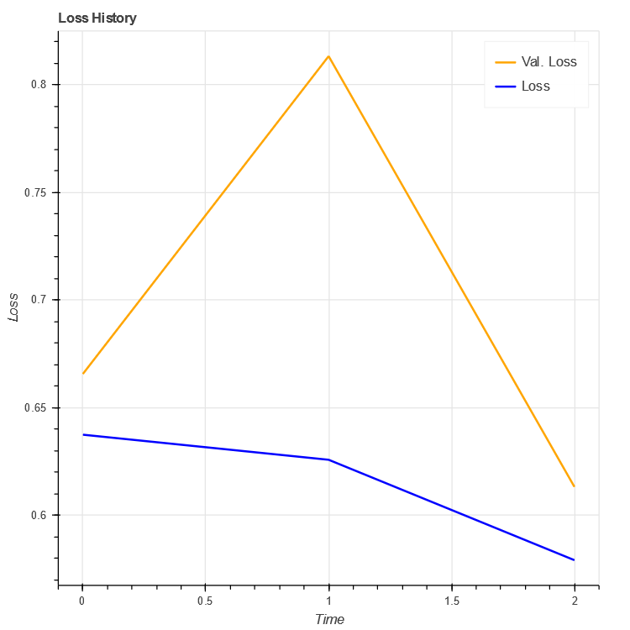
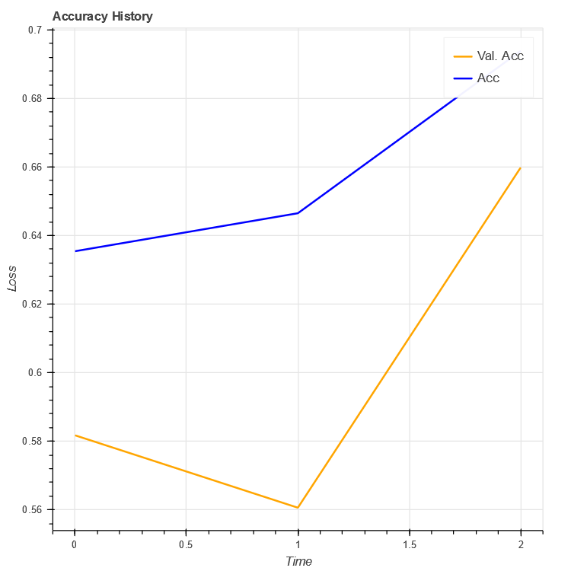
Result
Current Model 1 have achieved an accuracy of 65.98% and has a loss score of 61.33%.

Slide 17
Conclusion
RNN and its kind are a great way to do sentiment analysis with minimum amount of workflow. The validation accuracy is going up and the model accuracy is going up. So, we can conclude that model is performing well.

Slide 18
REFERENCES
A. Hassan, “SENTIMENT ANALYSIS WITH RECURRENT NEURAL NETWORK AND UNSUPERVISED Ph . D . Candidate : Abdalraouf Hassan , Advisor : Ausif Mahmood Dep of Computer Science and Engineering , University of Bridgeport , CT , 06604 , USA,” no. March, pp. 2–4, 2017.
Understanding RNNs, LSTMs (http://colah.github.io/posts/2015-08-Understanding-LSTMs/)

Slide 19
Balanced scorecard slide 10
THANK YOU

